Slide 1
Hash Functions Based on Block Ciphers
https://youtu.be/iQ3I7-CSdn8

Slide 2

Iterated hash functions and attacks
M
M₁ | M₂ | M₃ | M₄ | M₅ | M₆ | M₇ | M₈
H₀
h
h
h
h
h
h
h
h
H₁
H₂
H₃
H₄
H₅
H₆
H₇
H

Slide 3
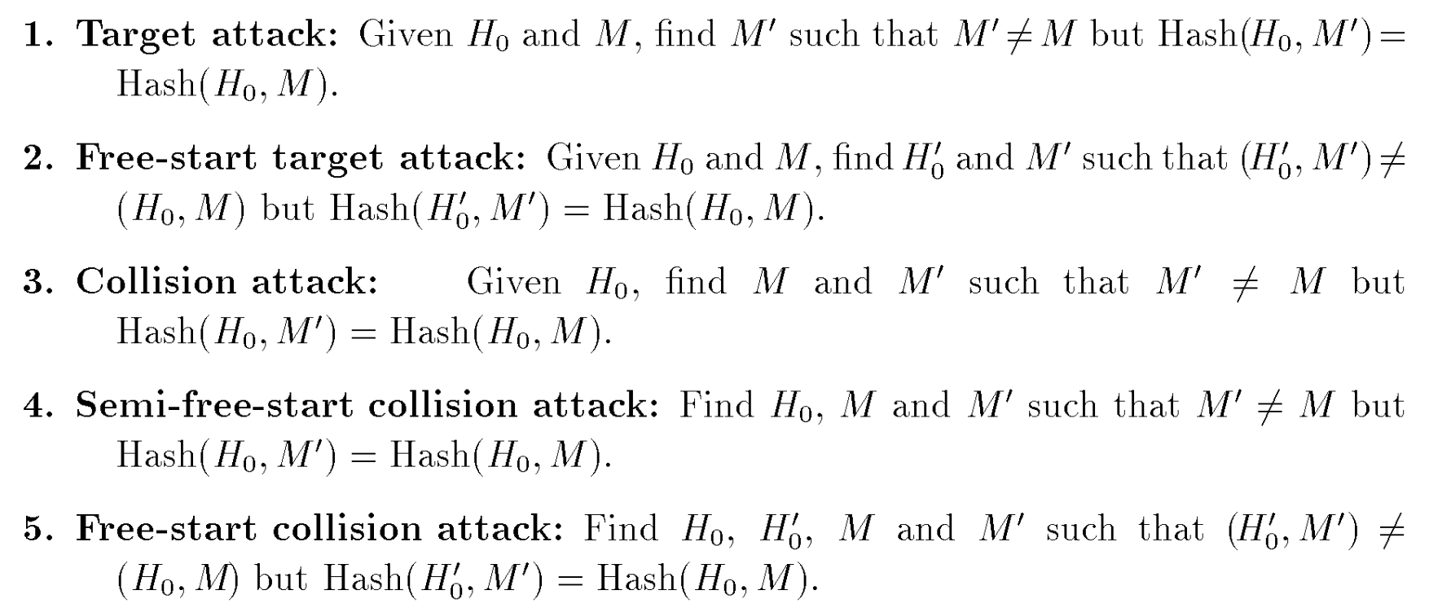
Iterated hash functions and attacks

Slide 4
Hash round functions based on block ciphers
E
M
M₁ | M₂ | M₃ | M₄ | M₅ | M₆ | M₇ | M₈
H₀
E
E
E
E
E
E
E
E
H₁
H₂
H₃
H₄
H₅
H₆
H₇
H

Slide 5

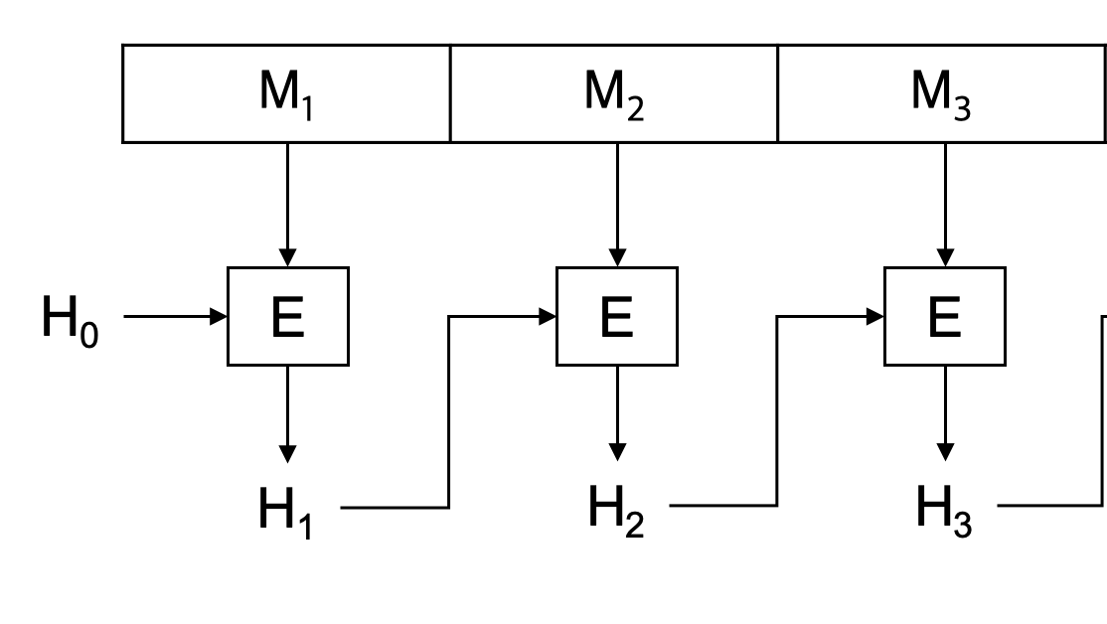
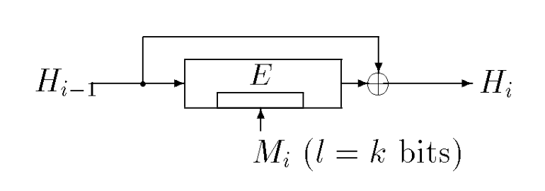
m-bit hash round functions
Davies-Meyer(DM) scheme
어느 블록 암호에나 적용 가능한 구조를 가지고 있음.
Hash size = block size(m-bit)
l size = key size
ex) PIPO-64/128 : Hash size(64-bit) / l size(128-bit)

Slide 6

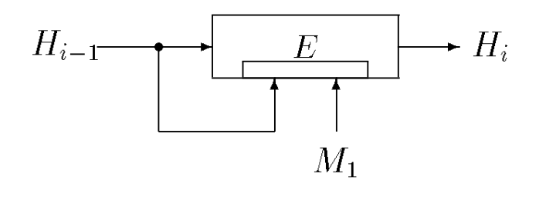
m-bit hash round functions
A proposed m-bit hash round function using a block cipher with m-bit block and 2m-bit key
Hash size = block size(m-bit)
l size = block size(m-bit)
ex) PIPO-64/128 : Hash size(64-bit) / l size(64-bit)

Slide 7
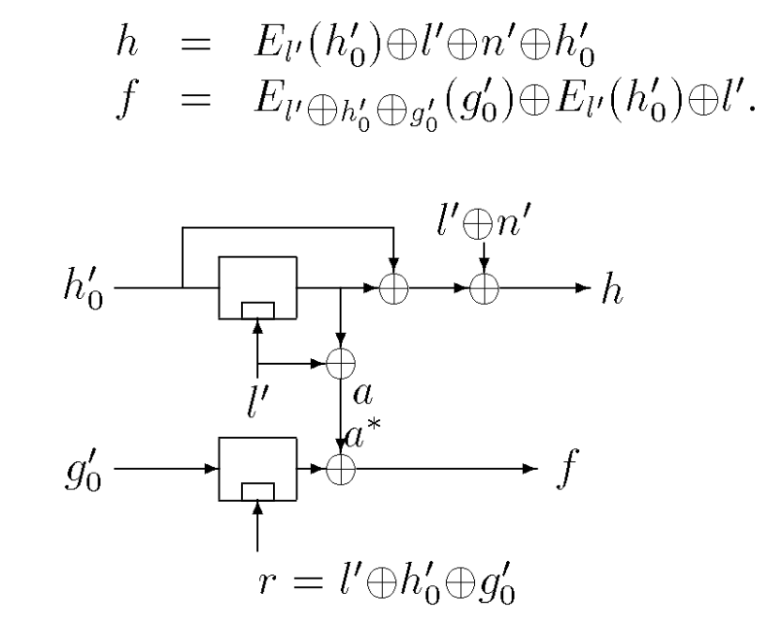
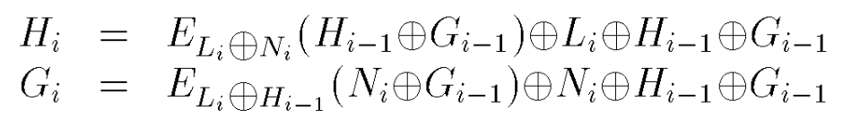
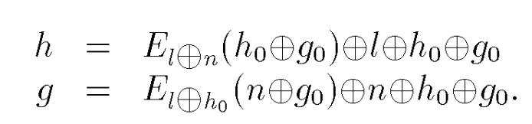

2m-bit hash round functions
The Preneel-Bosselaers-Govaerts-Vandewalle(PBGV) scheme
block size : m-bit , key size : m-bit
Hash size = 2 * block size(m-bit)
l size = key size(m-bit), M -> (L₁, N₁, … , L_{n}, N_{n})
ex) LEA-128/128 : Hash size(256-bit) / l size(128-bit)

Slide 8
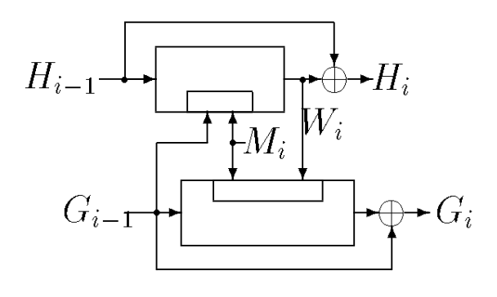
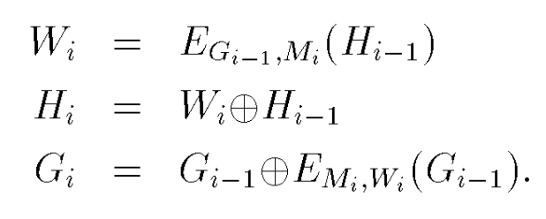
Proposed 2m-bit hash round functions
Tandem DM
두 개의 DM schemes 구조를 사용한 구조
Hash size = 2 * block size(m-bit)
l size = block size(m-bit)
ex) PIPO-64/128 : Hash size(128-bit) / l size(64-bit)

Slide 9
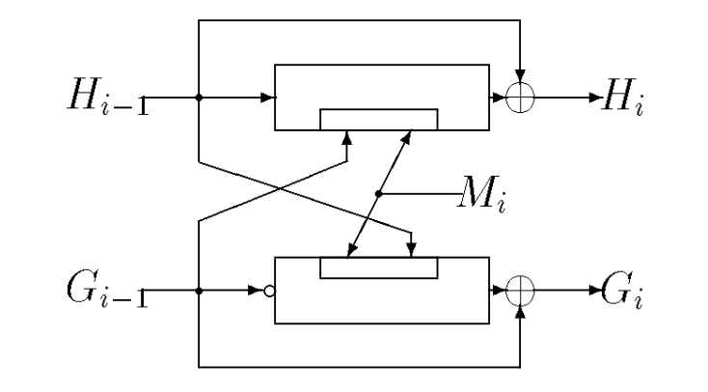
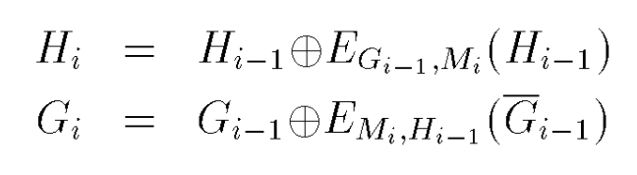
Proposed 2m-bit hash round functions
Abreast DM
두 개의 DM schemes 구조를 사용한 구조
Hash size = 2 * block size(m-bit)
l size = block size(m-bit)
ex) PIPO-64/128 : Hash size(128-bit) / l size(64-bit)

Slide 10
Tandem DM (PIPO, LEA, CHAM)
PIPO( 64/128, 64/256 )
PIPO-64/128
Hash size : 128-bit
LEA( 128/128, 128/192, 128/256 )
LEA-128/256
Hash size : 256-bit
CHAM( 64/128, 128/128, 128/256 )
CHAM-128/256
Hash size : 256-bit

Slide 11
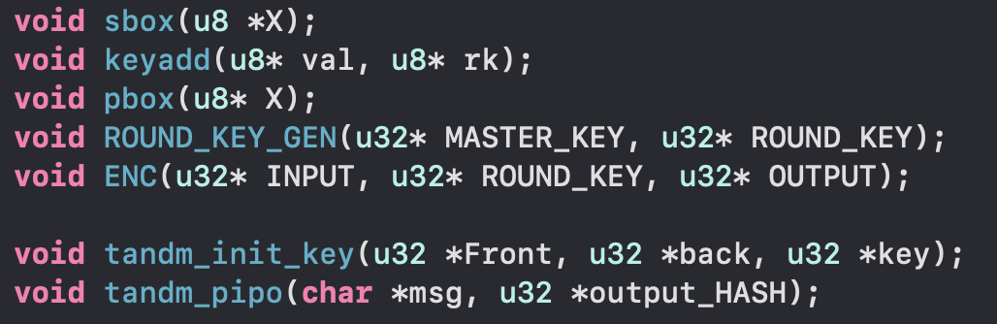
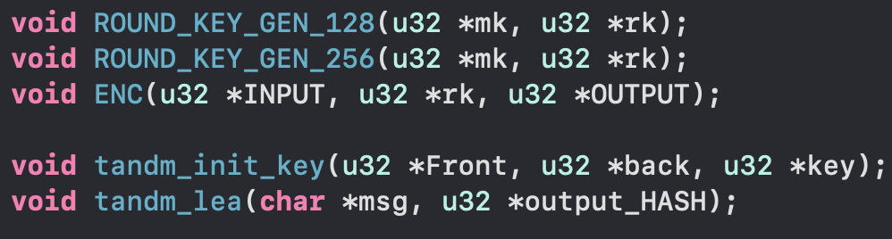
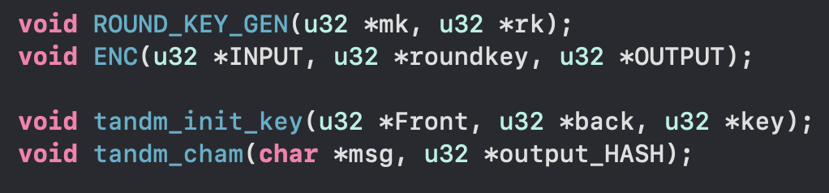
Tandem DM (PIPO, LEA, CHAM)
PIPO
LEA
CHAM

Slide 12
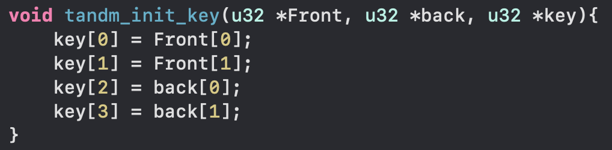
Tandem DM (PIPO, LEA, CHAM)

Slide 13
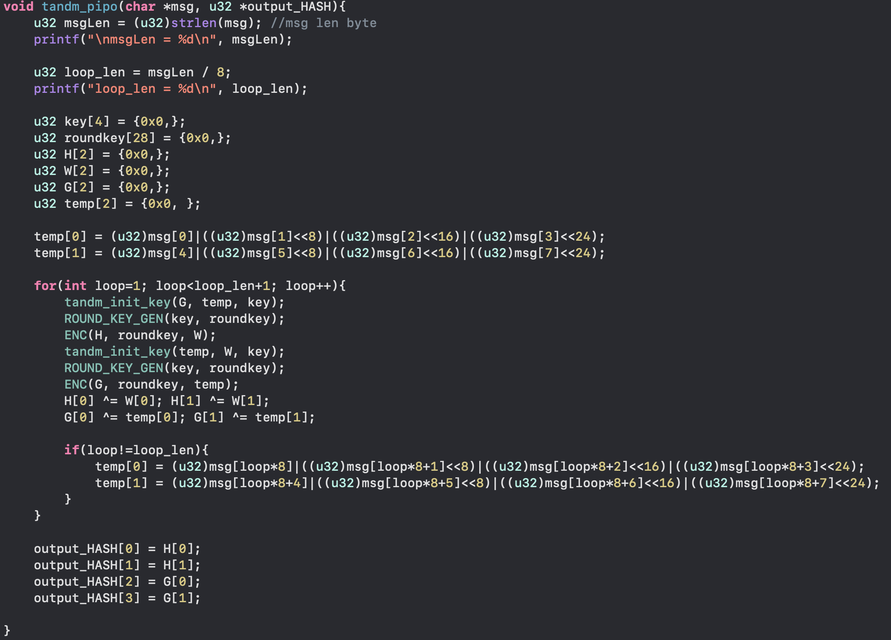
Tandem DM (PIPO, LEA, CHAM)

